Slide 1
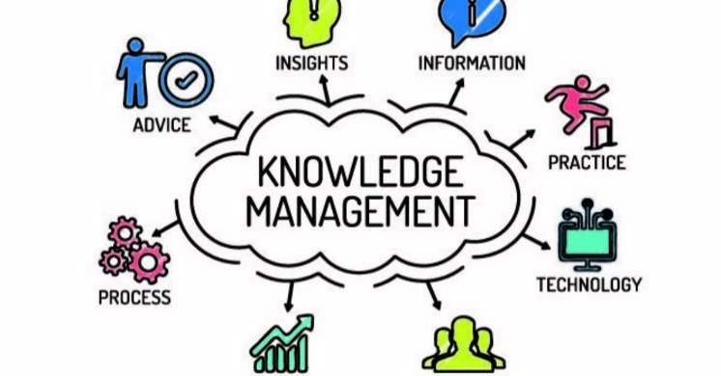
Knowledge Management & Innovation
Eunika MERCIER-LAURENT
Chair IFIP TC12 (AI)
Global Innovation Strategies
Research Center Université Lyon 3/CReSTIC Reims
eunika.mercier-laurent@epita.fr
http://innovation-ecosystems.eu

Slide 2
Agenda
Introductions
Knowledge Management
Why
Discovery (Project 1 Case Study)
Definitions, origins and dimensions
KM Methods
Innovation
Overview
Knowledge4Innovation and Sustainability
Project 2
AI for KM and Innovation
Traditional IT
AI
Projects presentation
Feedback

Slide 3
MOOC
MOOC https://ionisx.com/courses/5a436b71b5dd284ff3af0703/knowledge-management-and-innovation

Slide 4

Introductions
Who are you? Name, country, specialty, experience
What are your interests?
Your plans for the Future? (2y and 5y)
What you know about KM and innovation?
What techniques of AI you know/practice?
Your expectations for this course?

Slide 5

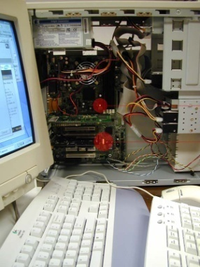
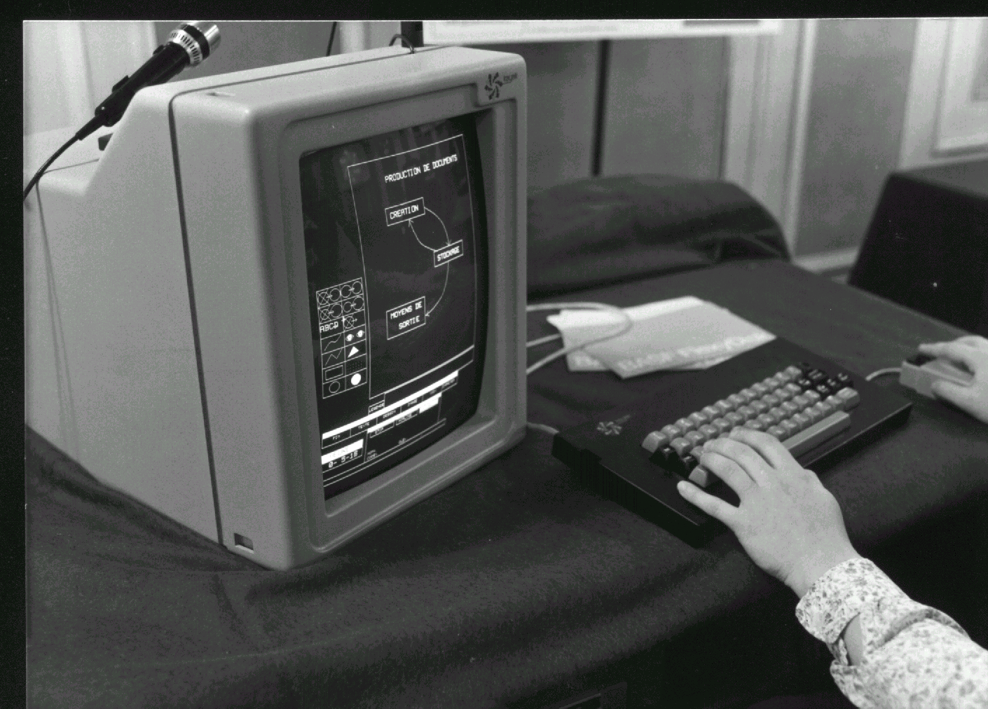



My experience
“AI inside”
Comprehension of collaboratif and global 1991
Computer design
KOOL, EDEN, Charme, Open KADS
Diagnostic (AI)
Innovative Applications
Notes:
Classement des fichiers Semantique du bureau, pdv
Superposer KADS, KOOL, charem, cbr

Slide 6
Corporate Knowledge

Slide 7





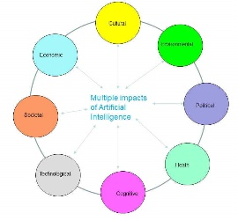




My experience (AI)
Knowledge Management
Innovation Management
Help desk
Notes:
Classement des fichiers Semantique du bureau, pdv
Superposer KADS, KOOL, charem, cbr

Slide 8



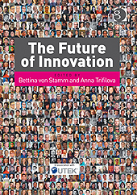
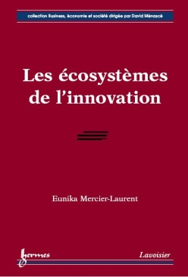







Books

Slide 9
Why Knowledge Management?
What link with innovation?
What added value for you?
https://www.youtube.com/watch?v=SHIa9LOroUg

Slide 10
Some « knowledgable » companies
https://www.kmworld.com/Articles/Editorial/Features/KMWorld-100-Companies-That-Matter-in-Knowledge-Management-2021-144846.aspx
https://www.kmworld.com/WhitePapers/BestPractices

Slide 11
Class wiki & collaborative space
http://epita22kmig2.pbworks.com
Ask for joining
Go to page Knowledge and Innovation Management
Create a page for your project

Slide 12
Projects – 2 parts
Case study – discover Knowledge Management in some companies/organizations
Apply what you learned – create and succeed your innovative company, using KM approach

Slide 13
Project part1 : discovery
Dusobox
https://www.youtube.com/watch?v=-9QPv61R9ZQ
Risk Management in Industry
https://www.youtube.com/watch?v=JYzitvRAZRw
Tesla motors https://www.thecasesolutions.com/knowledge-management-tesla-motors-42960
Amazon
https://aws.amazon.com/fr/connect/
Olympics Games KM https://realkm.com/2016/08/19/is-the-olympic-games-knowledge-management-ogkm-program-effective/

Slide 14
Project part1 : discovery
KM@NASA
https://www.nasa.gov/content/knowledge-management-km-resources
CIRAD https://collaboratif.cirad.fr/alfresco/s/d/workspace/SpacesStore/f660dd6f-c4ae-4ed9-a660-7f144f4f7310/Agroecologie-EN-1.pdf
Chinese IT company http://www.diva-portal.org/smash/get/diva2:617510/FULLTEXT01.pdf focus on relevant
ABB https://fr.slideshare.net/ansariboss9211/knowledge-management-report-on-abb-company

Slide 15
Project part1 : discovery
UNDP https://www.undp.org/publications/undps-knowledge-management-strategy
Agriculture from P.9
https://www.manage.gov.in/studymaterial/AKM-E.pdf
Smart City http://realkm.com/2016/07/22/smart-cities-and-knowledge-management/
https://blog.se.com/smart-cities/2017/10/03/smart-city/

Slide 16
Case 10-17 SME (select one)
http://www.apo-tokyo.org/publications/wp-content/uploads/sites/5/ind-40-km_smes-2010.pdf 1. Keppie Design: KM in a Scottish Architectural Practice 9 2. Care Service Improvement Partnership (CSIP) 16 3. AdvancedTEK International Corp. (AIC) 22 4. Arbor Technology 31 5. Qian Hu Corporation: Knowledge-based Ornamental Fish Farm 40 6. Goldsun Advertising and Marketing 49 7. Japan Gore-Tex (JGI): Sustainable Knowledge Creation for Innovation 59 8. Migakiya Syndicate: Cluster KM for Businesses Co-Creation among SMEs 65

Slide 17
Project part1 : discovery (early cases)
air industry http://www.innovationecology.com/papers/IAI%20case%20knowledgeboard%20ebook.pdf
Department of Health https://www.skyrme.com/kmcases/doh.htm

Slide 18
Project1: case study in groups (3-4) – answer the following questions
How KM was initiated? Who and why? (need, trend or push)?
Initial idea (tool, need, strategy)?
What professionals (R&D, marketing, designers, client service…) are involved, how and why?
What kind of knowledge is managed and how? (know-how, customer knowledge, tips, about competitors….)
What are the basic components of KM? (innovation management, talents management, project management, document management, customer services….)
How the Kflow is organized?

Slide 19
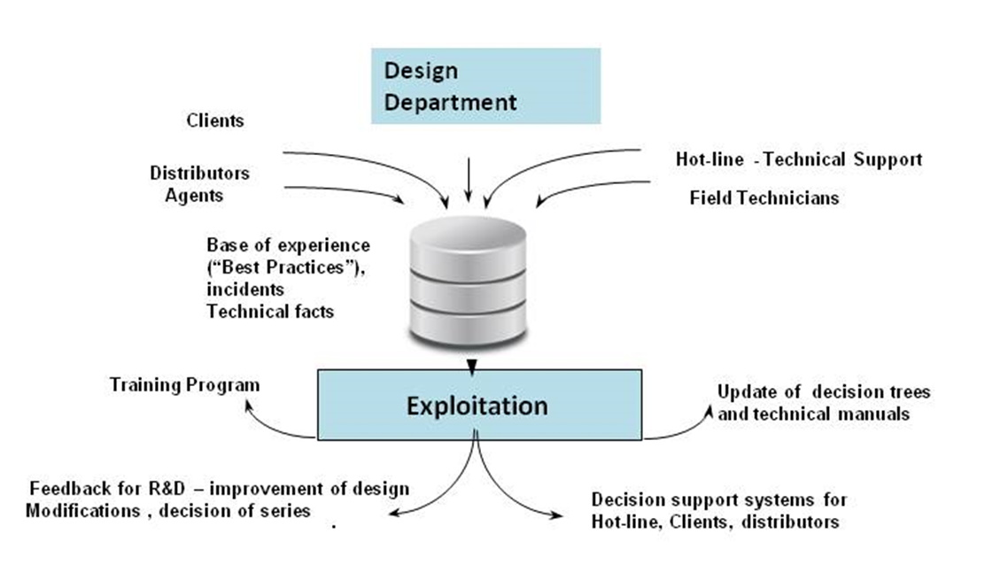
Example of Kflow

Slide 20
Project1: case study – answer the following questions
7. What technology supports KM ? (social networks, intranet, wiki, AI….)
8. What are the benefits? (ROI tangible & intangible)
9. Your comments (effective? helpful?..)

Slide 21
Presentation
on class wiki – create page – collaborative writing, link to presentation
to your colleagues or video
NB You learn from each presentation !!!

Slide 22
Agenda
Introductions
Knowledge Management
definitions, origins and dimensions
KM Methods
Projects:
Understand KM ways (case analysis)
Apply
Innovation
Overview
Knowledge4Innovation and Sustainability
ICT for KM and Innovation
Traditional
AI
Projects presentation
Feedback

Slide 23
KM@Deimler
https://www.youtube.com/watch?v=amX2JyhFUiE
Discussion
Why KM
What?
How?

Slide 24
Corporate Knowledge

Slide 25
Knowledge is Different
Insight, creates meaning,
judgmental, actionable, decision taking, intelligence
Human, tacit, information with context, transfer requires learning
Wisdom
Knowledge
Information
Contextual, data with meaning
Codifiable, explicit
Easily transferable
Data

Slide 26
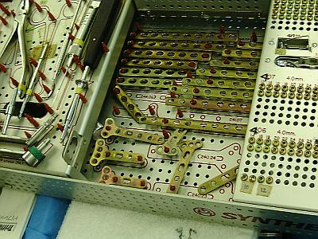
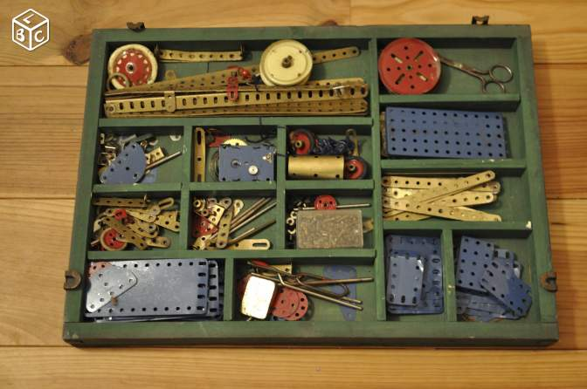
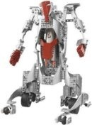
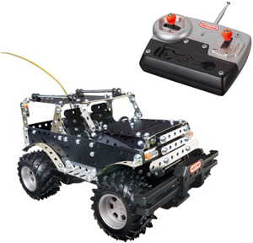
Condition: “Think differently” capability
Data approach Knowledge approach
Collect first Understand first

Slide 27

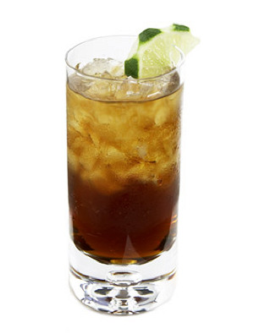
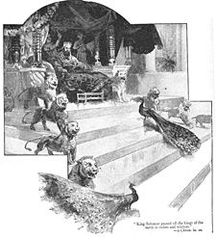
March 15th, 1987
2 87 03 99 122 108 79
Juan was born March 15th, 1976 in Mexico City
Cuba libre
Cracked ice 2 ounces white rum 2 ounces Coca-Cola 1 lime wedge
In a tall glass, pour the rum over the ice, and fill the glass with Coca-Cola, finishing with the lime wedge. Serve.

Slide 28
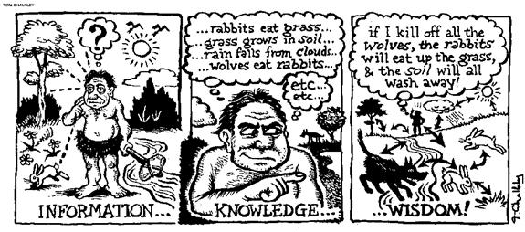

Slide 29
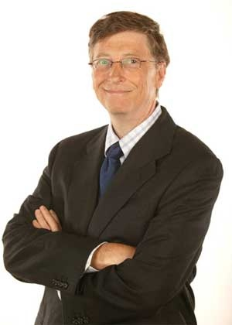
Knowledge Management
"Knowledge management is nothing more than managing information flow, getting the right information to the people who need it so that they can act on it quickly."
"Business @ the Speed of Though" p. 238 (1999)

Slide 30
Knowledge Management Debra M. AMIDON, ENTOVATION International Eunika MERCIER-LAURENT, KIM
An integrated system of
Initiatives, methods & tools
designed to create
an optimal flow of knowledge
within and throughout
an extended enterprise
to ensure stakeholders
success

Slide 31

Kflow
“Creation, collection, processing and sharing of information and knowledge in an organized and optimized way, taking into consideration the various activities of the extended organization as well as needs and individual and collective motivations of all participants”

Slide 32
KM Origins
Management: Five generations of management methods
AI: knowledge acquisition, Kmodeling, processing, problem solving approach, Decision Support Systems, machine learning, K discovery, NLP, constraint programming, MAS…
Marketing: Business Intelligence, e-commerce
Human resources mgt: Intellectual Capital
Notes:
AI community worked a lot on
We have applied these approaches and technics to difficult industrial problem solving and we have understood and evolved throug this experience
ES, CBR, MAS, CP..
Marketing, has tried different approaches, as customer retention, customer satisfaction and now they innovate with customer. One of french banks Paribas has initialised a forum on actual problems and all participants contibute to creation of new products ans services. BI is now amplified by Internet information access.
Last week I participated in a world congres on HR. More and more they are talking not about HR management but about capacity mgt
Classic IT has invented
quality - strategy understanding

Slide 33
KM as Management Method
5 Generations of Management Styles (Savage 1991
Innovation Strategy for The Knowledge Economy (Amidon 1997)
1st Technology as the Asset
2nd Project as the Asset
3rd Enterprise as the Asset
4th Customer as the Asset
5th Knowledge as the Asset
Core Strategy
R&D in Isolation
Link to Business
Technology/ Business Integration
Integration With Customer R&D
Collaborative Innovation System
Change Factors
Unpredictable Serendipity
Inter- dependence
Systematic R&D Management
Accelerated Discontinuous Global Change
Kaleidoscopic Dynamics
Performance
R&D as Overhead
Cost-Sharing
Balancing Risk/Reward
‘Productivity Paradox’
Intellectual Capacity/ Impact
Structure
Hierarchical; Functionally- Driven
Matrix
Distributed Coordination
Multi-Dimensional ‘Communities of Practice’
Symbiotic Networks
People
We/They Competition
Proactive Cooperation
Structured Collaboration
Focus on Values and Capability
Self-Managing Knowledge Workers
Process
Minimal Communication
Project-to- Project Basis
Purposeful R&D/Portfolio
Feedback Loops and ‘information persistence’
Cross-Boundary Learning and Knowledge Flow
Technology
Embryonic
Data-Based
Information- Based
IT as a Competitive Weapon
Intelligent Knowledge Processors
Customer Retention
Customer Satisfaction
Customer Success

Slide 34
KM Origins
IT: DB, Networks, Groupware, Intranet, Data Warehouse, ERP, CRM…
Document management
Design Concurrent engineering, DT, AI by design…
Economy (knowledge based business, innovation)
Analytics ? or knowledge discovery?
Multitude of heterogenous sources
Notes:
AI community worked a lot on
We have applied these approaches and technics to difficult industrial problem solving and we have understood and evolved throug this experience
ES, CBR, MAS, CP..
Marketing, has tried different approaches, as customer retention, customer satisfaction and now they innovate with customer. One of french banks Paribas has initialised a forum on actual problems and all participants contibute to creation of new products ans services. BI is now amplified by Internet information access.
Last week I participated in a world congres on HR. More and more they are talking not about HR management but about capacity mgt
Classic IT has invented
quality - strategy understanding

Slide 35
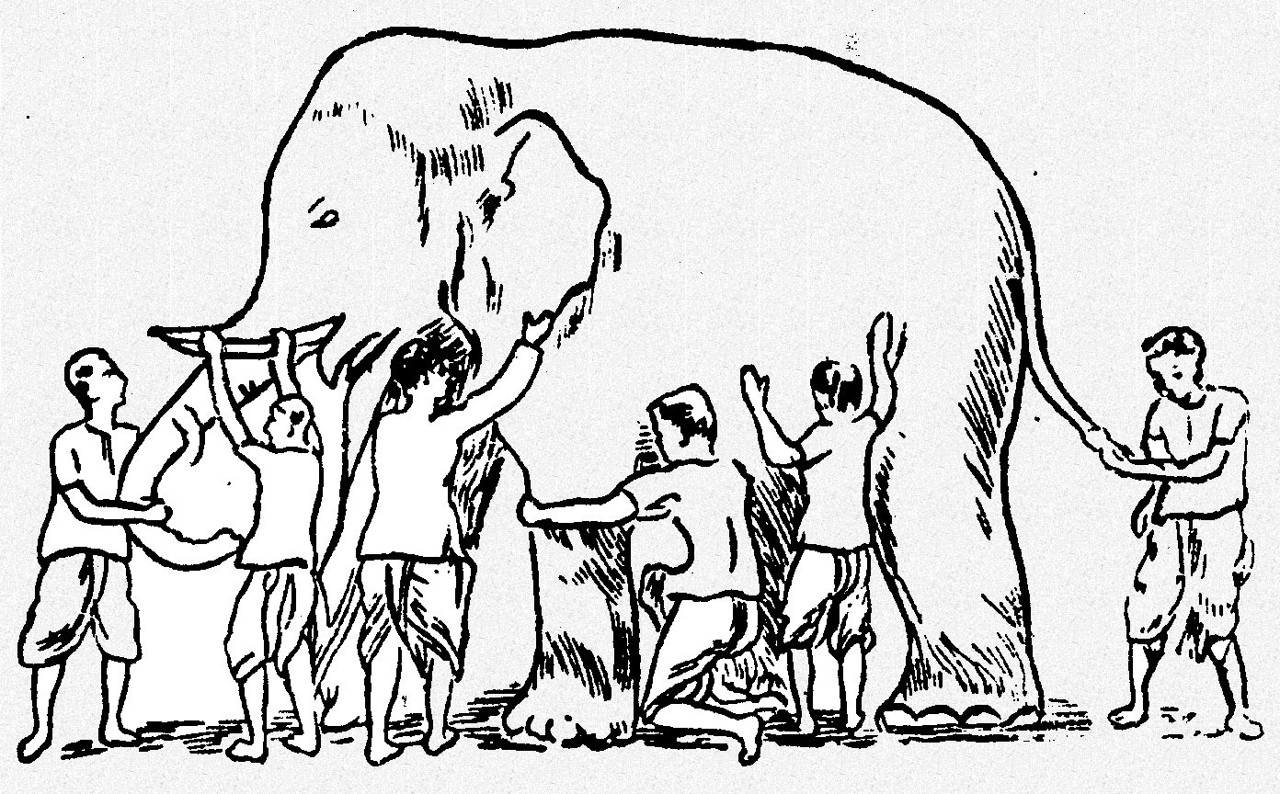
KM in real life
; the one who feels the ear says the elephant is like a hand fan;
The blind man who feels a leg says the elephant is like a pillar;
the one who feels the tail says the elephant is like a rope;
the one who feels the belly says the elephant is like a wall;
the one who feels the trunk says the elephant is like a tree branch
and the one who feels the tusk says the elephant is like a solid pipe.

Slide 36

New trends (without or discovering KM)
Disaster/risk management
Sustainability & Climate change
Corporate Social Responsibility
Social/Societal Innovation
Knowledge Economy
Product-service economy
Circular economy
Innovation Management

Slide 37


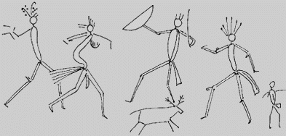
Knowledge Economy
Knowledge Economy
Industry
Agriculture
intangible
Hunting
& gathering
Faster, cheaper, better
Scarcity & control

Slide 38
KM in practice
Tool oriented
BD, Excel
Groupware (collaborative work)
Intranet
Web 2.0
Collaborative
Social networks
Semantic web
Serious games
Big data & machine learning?
AI inside ?
Notes:
Classic IT has invented
quality - strategy understanding

Slide 39
KM in Practice
User’s activity oriented
Help desk, diagnostic, decision support systems
K capitalization
IT practices, other “best practice”
Content management
Design (& eco-design)
Skills & Competency management
Business Intelligence
E-learning
Notes:
AI community worked a lot on
We have applied these approaches and technics to difficult industrial problem solving and we have understood and evolved throug this experience
ES, CBR, MAS, CP..
Marketing, has tried different approaches, as customer retention, customer satisfaction and now they innovate with customer. One of french banks Paribas has initialised a forum on actual problems and all participants contibute to creation of new products ans services. BI is now amplified by Internet information access.
Last week I participated in a world congres on HR. More and more they are talking not about HR management but about capacity mgt
Classic IT has invented
quality - strategy understanding

Slide 40
KM in Practice
Management oriented
Innovation process management
Sustainability (all components), ex UN goals
CSR
Climate change
Leadership management
Well-being
Notes:
AI community worked a lot on
We have applied these approaches and technics to difficult industrial problem solving and we have understood and evolved throug this experience
ES, CBR, MAS, CP..
Marketing, has tried different approaches, as customer retention, customer satisfaction and now they innovate with customer. One of french banks Paribas has initialised a forum on actual problems and all participants contibute to creation of new products ans services. BI is now amplified by Internet information access.
Last week I participated in a world congres on HR. More and more they are talking not about HR management but about capacity mgt
Classic IT has invented
quality - strategy understanding

Slide 41
KM Today – tool or user’s oriented
Collaborative work
Social networks
Business Intelligence
CRM (with AI)
Decision support sys
Project Management
Process Management
Knowledge discovery
Collective experience
Storytelling
Objective : optimized Knowledge flow

Slide 42
KM – not enough in
IS
Marketing, e-commerce
ERP
CS
Green software
Digital transformation

Slide 43
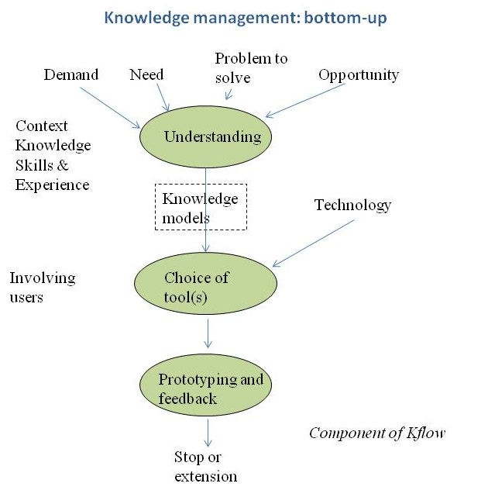
or
or

Slide 44
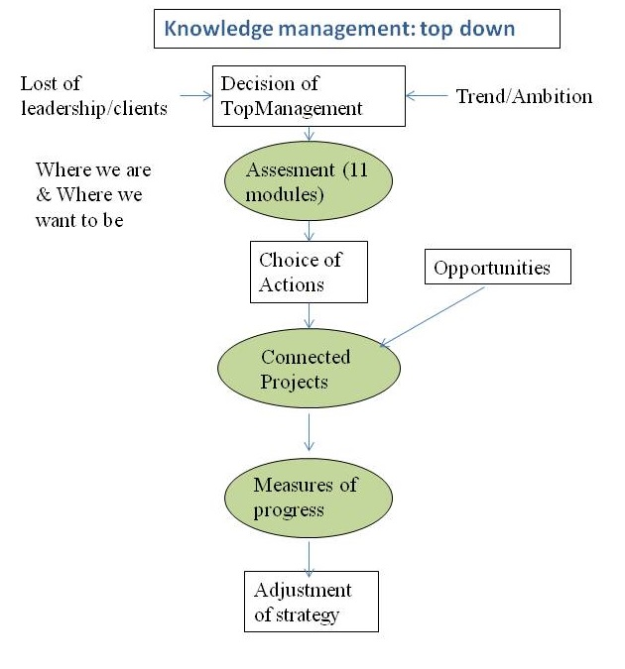

Slide 45
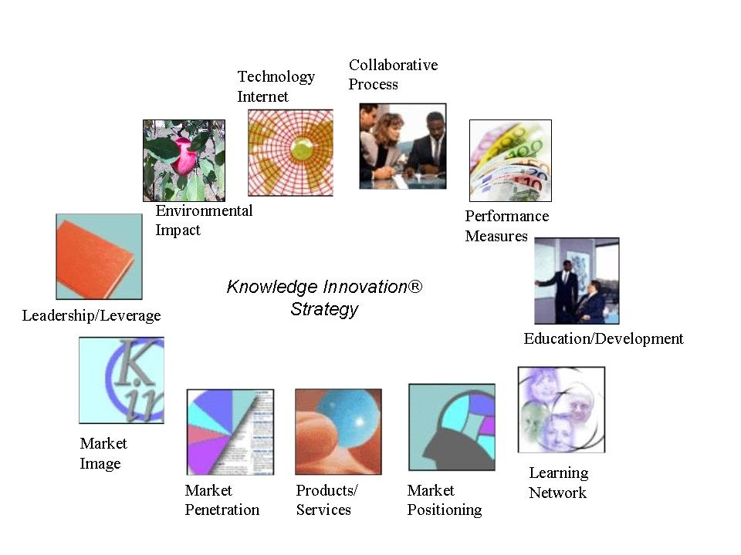
KM Methods: Top down Analysis of innovative capacity

Slide 46
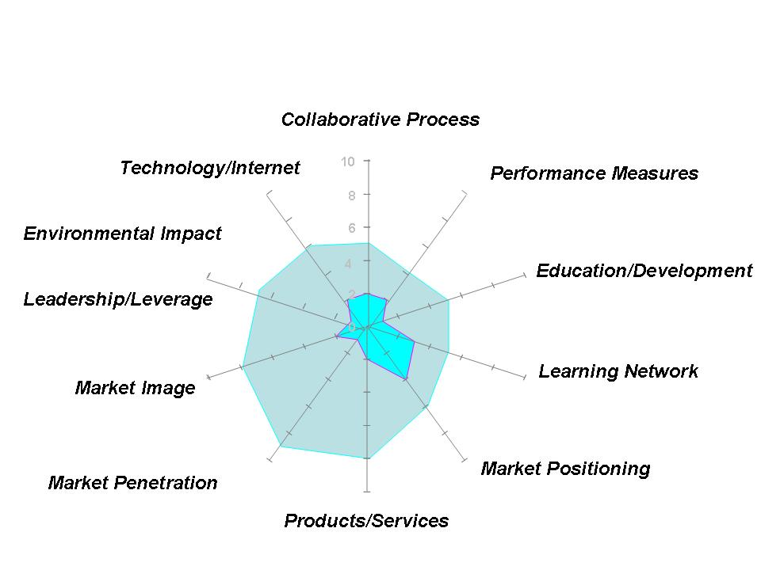
KM Methods Top down Gap Analysis

Slide 47
When
If you have access to top-management
Bottom-up supervised by top-down

Slide 48
Example of application
Schneider Electric

Slide 49
Initial demand of Marketing Corp
Help desk on-line 24/7
Specific problem solving

Slide 50
1. Understanding
Problem understanding = 80% of solution !
Context: existing & influence factors
Knowledge related to problem solving & actors
Motivations
Culture
Discovering hidden needs > choice of objective > strategy > tactics
Notes:
90% des connaissances sont tacites et se trouvent dans les tetes, pas facile à mettre en commun et à traiter en automatique

Slide 51

Context
Schneider
worldwide, over 100 countries
electrical equipments
4 groups (merging and acquisition)
Schneider Electric
Merlin Gerin
Telemecanique
Modicon
Notes:
The problem they ask for was an on-line help desk system. they wanted to give an added value on line for selected customers and got $ for this service.
Several years ago, they have bought 3 others companies
still different enterprise culture, Telemecanique, Square D, Modicon
We have begun to work on one type of equipment sold wolrdwide.

Slide 52
Initial Situation
Corporate Marketing wish : add new payed services on line, ex help desk 24/7
Excellent knowledge of products
Lack of knowledge about customers
Lead - Modicon

Slide 53
Communication (initial)
Marketing
Distributors
Competitors
Commercial
Clients
Training
TechnicalSupport
R&D
HR

Slide 54
Discovering real needs
Customer satisfaction
Know customers to detect new needs for products and services
Get K from stakeholders (distributors, clients)
Provide intelligent sales support (examples)
Share gained knowledge for internal use (training, easy access, improvement of products/services…)
Notes:
We have begun to solve one problem and we have discovered others.

Slide 55
Tactics
Choice of the most important problem to solve
Analysis : where knowledge is, how it is produced and shared by all E actors, who needs K and for what
Economic and cultural aspects
Glossary and points of view (international)
Modelling and choice of tool(s)
Extension ( -> organizational changes may appear..) need for CKO
Notes:
most important
help desk, but we have discovered other needs global experience base, customer satisfaction
5 similar projets in the world
Glossary for all involved,We had not spent time on glossary definition, it is build progressively.
Tool was already choosen by CEO, than we have spent time to adapt problem to the tool.
Sharing power problems - involved teams come from different departements and have different hierarchy. We have solved by temporary detachement for project. All new taem has a common goal to build collective experience

Slide 56
Building a Kflow
Do small think global
Specific Problem Solving
Collective Knowledge on Technical pb solving

Slide 57
Main difficulties
Tool was chosen first
Building a global Kflow involves change
Multicultural environment – translation & interface
Motivation to collaborate (common goal, interesting work, high pay, promise of reward, prize, fear)
people who have a common goal are motivated to work together;
Economic, Technological, Cultural…
Notes:
temporary attachement people having common goal are able to work together without hierarchy.
different languages - easy translation
communication by design or english and translation country by country
cultures italian customer wants to see his technician
ETB, 3 main components of GKM

Slide 58
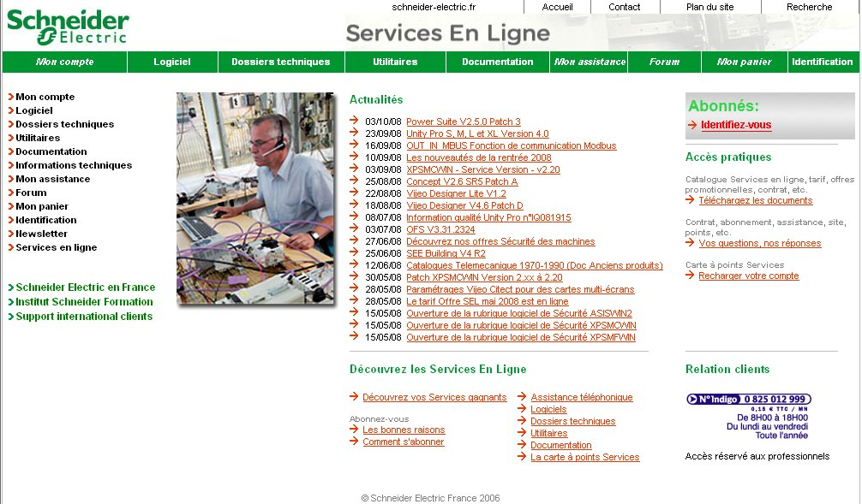
SE Today’s operational system
http://xsl.schneider-electric.com/accueilInit.do
Notes:
temporary attachement people having common goal are able to work together without hierarchy.
different languages - easy translation
communication by design or english and translation country by country
cultures italian customer wants to see his technician
ETB, 3 main components of GKM

Slide 59
KM « Recipe »
Understand
Context
What, why, who… – needs
Nature of knowledge - model
Choice of tool(s) vs hybrid
Incremental (do small think global), or
Top-down?
MEASURES of progress

Slide 60
KM - principle
Initiatives
Methods: organization and implementation
Tools
Benefits
Principle: intelligent assistant of human

Slide 61
Influence of AI
Way of thinking
Knowledge modeling (Kbblocs) and processing (Kbrain)
Reasoning
Discovery
Problem solving (DSS)

